Slide 1
Transport Layer Protocols
Dr. Geetha V
Asst Professor,
Dept of IT,
NITK, Surathkal

Slide 2
Index
Introduction
TCP Header Format
3. TCP state diagram

Slide 3
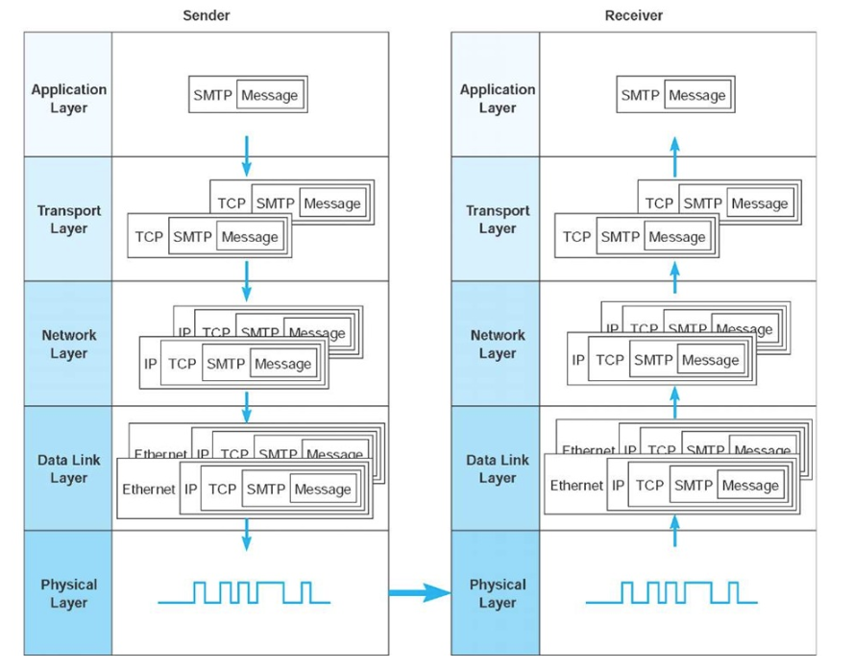
Message Transmission using Layers [1]

Slide 4
Functions of Transport Layer
Guarantees message delivery
Delivers messages in the same order they are sent
Delivers at most one copy of each message
Supports arbitrarily large messages
Allows the receiver to apply flow control to the sender
Supports multiple application processes on each host

Slide 5
Limitations of Network Layer
Drop messages : Due to link failure or buffer full
Reorder messages: Due to packets may travel in different path
Deliver Duplicate copies: Due to timeout
Limit messages to some finite size: Due to network limitation
Deliver messages after an arbitrarily long delay: due to delay in path or queue

Slide 6
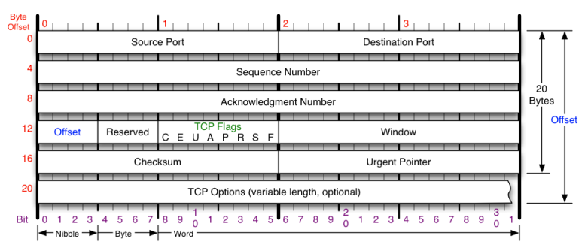
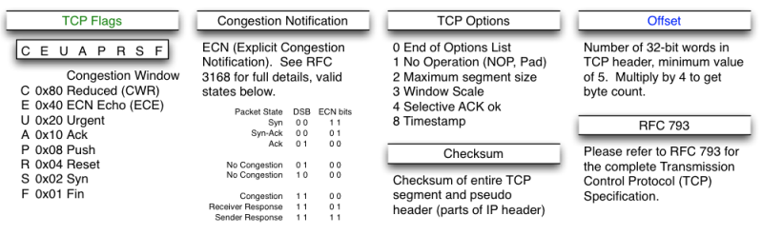
TCP Header Format

Slide 7
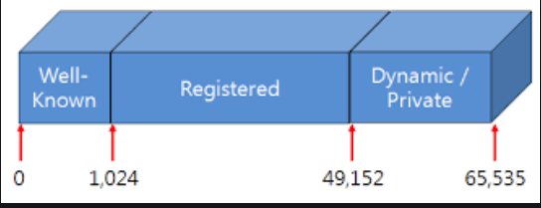
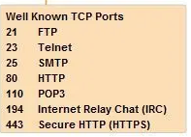

TCP Header
Total data bytes:
65,535-20-20=65,515 bytes (TCP Header 20 and IP header 20)
Source and Destination Port:

Slide 8
TCP Header
Sequence Number (x) and Acknowledgement Number (x+1) :- Indicates the next byte to be received.
32 bit => its numbers are based on number of bytes
Example: explain

Slide 9
TCP Header
Offset/TCP header length (no. of words) : number of 32 bit words in header
5 words => 5 x 4 = 20 bytes (without Options)
Options:
U: URG: Urgent Pointer: U=1 Urgent pointer is valid
A: ACK: A=1 Acknowledgment is Valid
P: PSH: P=1: Push data to application upon arrival
R: RST: R=1 Reset the connection
S: SYN S=1 and A=0: Establish Connection
F: FIN F=1: Release a connection

Slide 10
TCP Header
Window Size:
Sliding window flow control
How many bytes may be sent starting at the byte acknowledged
Synchronization ( 3 way handshake between sender and receiver)
Window size advertisement (example)
Nagle’s Algorithm: Send one byte from sender and buffer other bytes till it receives ACK
Issue - Low bandwidth utilization
Silly Window syndrome : Sending large blocks from sender and receiver, buffer is full and ACK for every byte getting free.
Issue – Every byte extra header overhead (TCP and IP)
Clark’ s Solution: Receiver must wait and advertise only when sufficient buffer space is available
Issue: Sender must wait and it may increase response time.

Slide 11
Reference
http://what-when-how.com/data-communications-and-networking/network-and-transport-layers-data-communications-and-networking/

